Slide 1
Multimedia Computing
By
Minhaz Uddin Ahmed, PhD
Department of Computer Engineering
Inha University in Tashkent.
Email: minhaz.ahmed@gmail.com

Slide 2
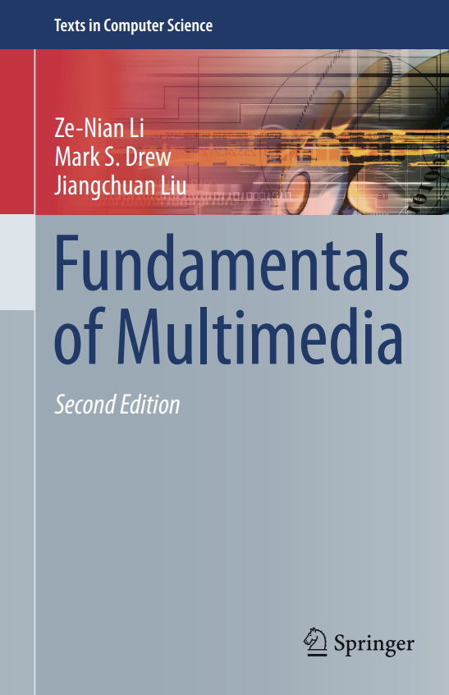

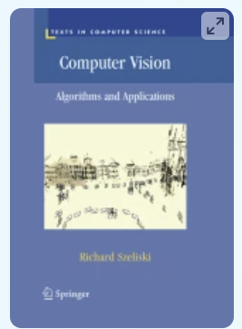
Course Overview
Textbook
Multimedia
Image processing
Computer Vision

Slide 3
Course overview
Course Evaluation:
  Mid term Exam 30%
  Final Exam 30%
  Assignment 15%
  Quiz 20%
  Attendance 5%+ class activity 10%
Assignments are based on python programming

Slide 4
Course Syllabus
Week | Content
Week One | Introduction to Multimedia computing
Week Two | Audio Analysis Nature of Sound Waveform Digitization
Week Three | Audio Analysis Audio Processing Audio Compression Perceptually based compression
Week Four | Image data representation Fundamental Physics of image Intensity transformation
Week Five | Color in Image processing Color image processing feature extraction XYZ to RGB transform

Slide 5
Course Syllabus
Week | Content
Week six | Fundamental concepts in Video NTSC vs PAL 3D camera model Video compression
Week Seven | Image Processing Image pattern classification
Week Eight | Mid-Term Exam
Week Nine | Computer Graphics Raster images Raster Devices
Week Ten | Computer Graphics Basic Ray-Tracing Algorithm Ray-Object Intersection

Slide 6
Course Syllabus
Week | Content
Week Eleven | Computer Vision Application of Computer Vision Topics in Computer Vision Recent research work
Week Twelve | Computer Vision Canny edge detector Harris Corner detector Feature matching/ Analysis
Week Thirteen | Computer Vision Stereo Model Fitting Segmentation
Week Fourteen | Computer Vision Recognition Classification Generative AI in CV
Week Fifteen | Final Exam
Week Sixteen | Review Class

Slide 7

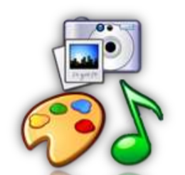
Introduction to multimedia
Multimedia is media and contents that uses a combination of different content forms.
Multimedia includes a combination of
Text
Audio
Still Images
Animation Video
Interactivity content forms

Slide 8
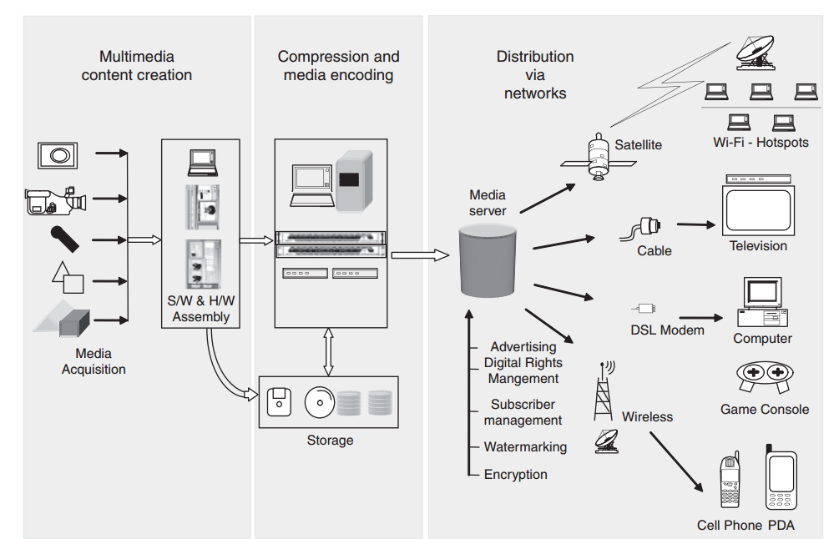
Introduction to multimedia
Figure 1-2 Components of a multimedia system today

Slide 9
Introduction to multimedia
1. A PowerPoint presentation. PowerPoint presentations involve all types of media and have tools to make it interactive.
2. Playing a video game. Video games are inherently interactive.
3. Describing a picture to your friend.
4. Reading the newspaper in the morning.
5. Videoconferencing.
6. Watching television or listening to radio.
7.TV comprises audio and video, with channel surfing as interactivity.

Slide 10
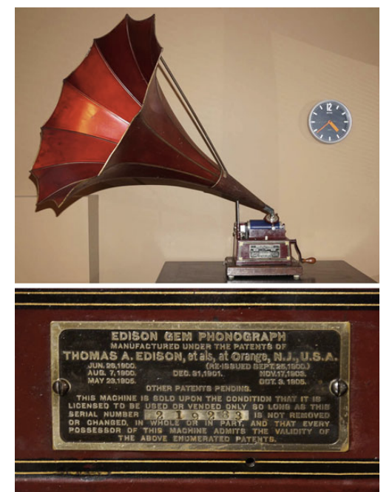
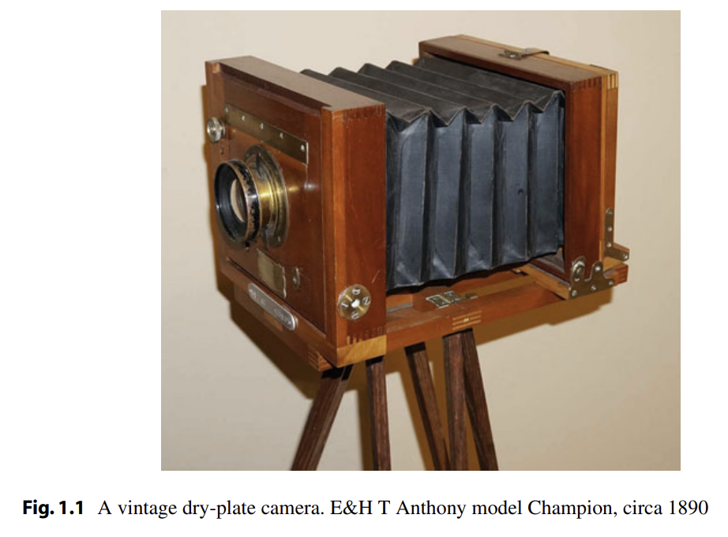
History of Multimedia
Thomas Alva Edison’s phonograph, invented in 1877, was the first device that was able to record and reproduce sound.

Slide 11
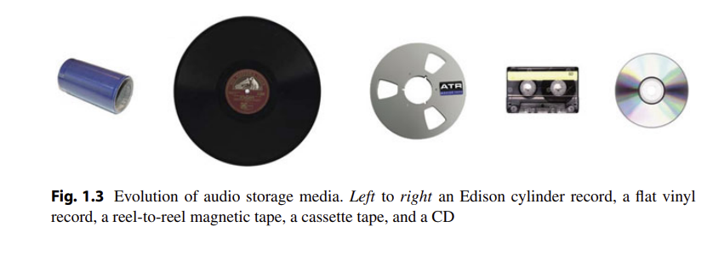
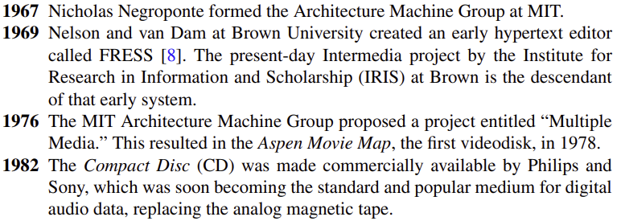
Evolution of audio storage media

Slide 12
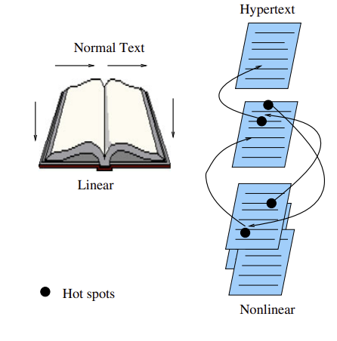
Introduction to multimedia computing
TEXT
Text is the most widely used and flexible means of presenting information on screen and conveying ideas.
Text is an essential aspect of presenting the information.
Like each element of the multimedia design, effective use of text can either direct users/readers attention or divert it.

Slide 13
Hypermedia
Hypermedia, first introduced by Ted Nelson, went beyond text-only. It includes a wide array of media, such as graphics, images, and especially the continuous media—sound and video, and links them together. The World Wide Web (WWW or simply Web) is the best example of a hypermedia application

Slide 14
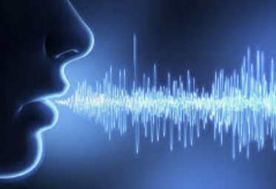
AUDIO
Audio refers to sound. Multimedia can include files which contain sounds
Audio songs also come under the heading multimedia
Multimedia presentations often have some audio tracks which makes it easier for people to understand.
Multimedia phones have music players to run audio music
Various audio software include VLC media player, real player, etc

Slide 15
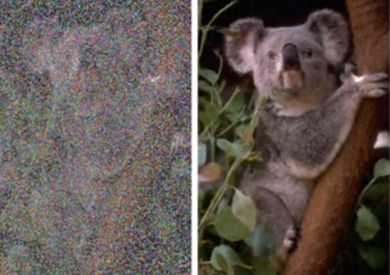
Images
Pictures(images) is a two-dimensional screen display, and as well as a three-dimensional, such as a statue or hologram.
Graphs, pie-charts, painting etc. all come under images.
Images are a very useful feature of multimedia. Multimedia presentation uses pictures or clip-art to make people understand.
Various file formats of images are .jpg, .png, .gif etc

Slide 16
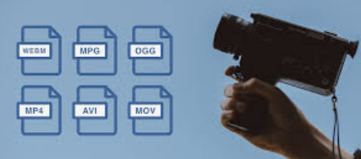
VIDEO
A video is unedited material as it had been originally filmed by movie camera or recorded by a video camera.
The embedding of video in multimedia applications is a powerful way to convey information which can incorporate a personal element which other media lack.
Video enhances, dramatizes, and gives impact to your multimedia application.
The advantage of integrating video into a multimedia presentation is the capacity to effectively convey a great deal of information in the least amount of time

Slide 17
Applications of digital image processing
Necessity of digital image processing
-Improvement of pictorial information for human perception
-Image processing for autonomous machine application
-Efficient storage and transmission

Slide 18
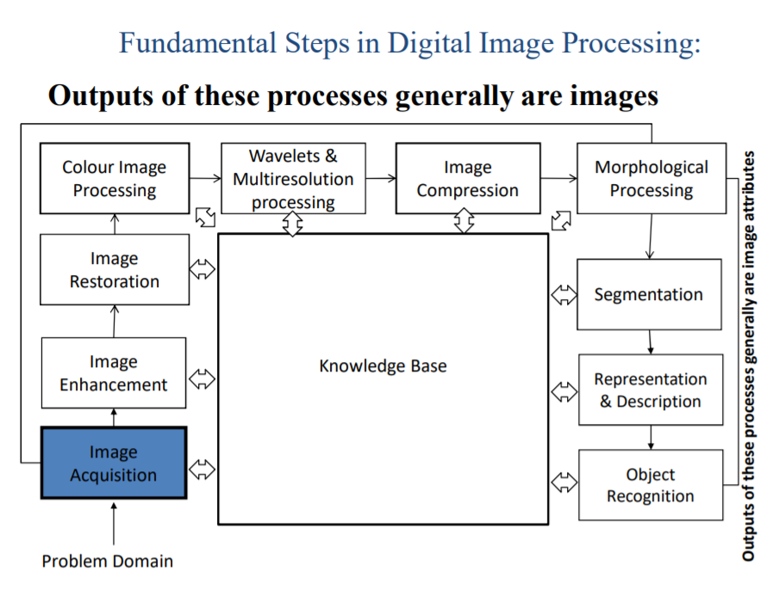
Key steps in digital image processing

Slide 19
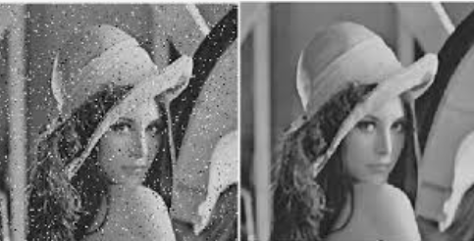
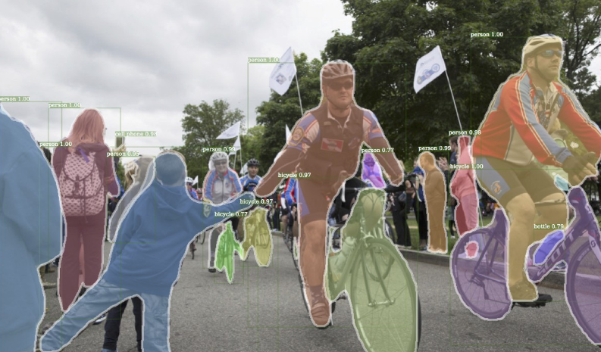
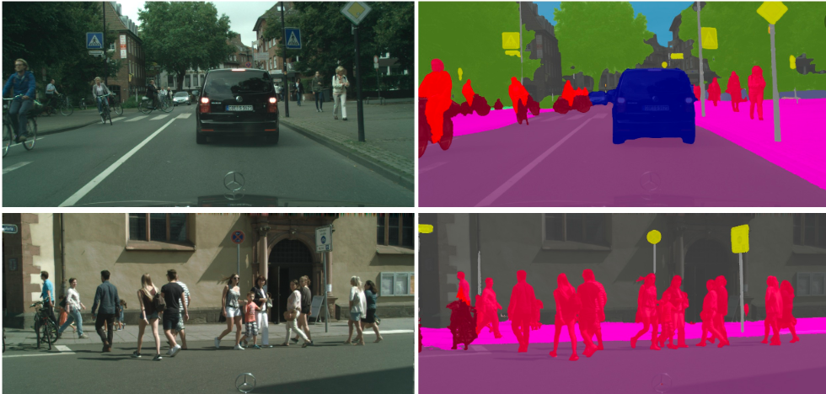
Image processing applied to computer vision
Low level (Noise removal, image sharpening)
Mid level (object segmentation)
High level (Scene understanding)

Slide 20
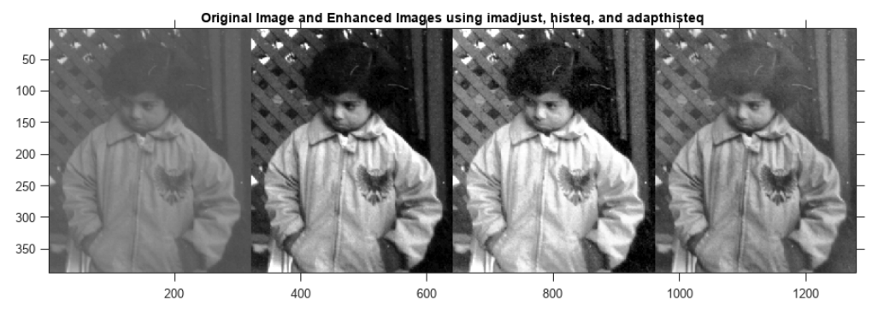
Improvement of pictorial information for human perception
Noise filtering
Content enhancement
  Contrast enhancement
  Deblurring
Remote sensing

Slide 21
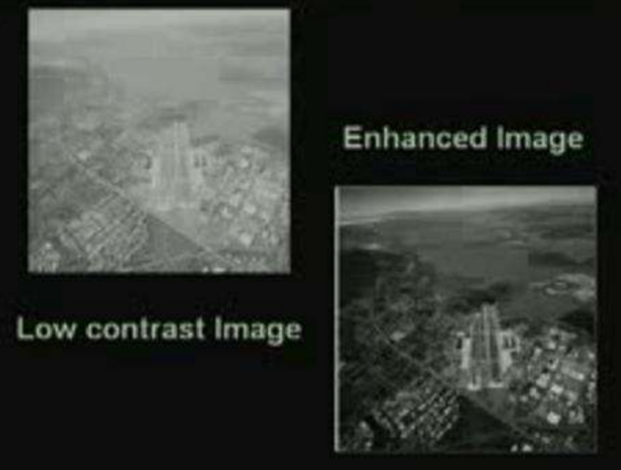
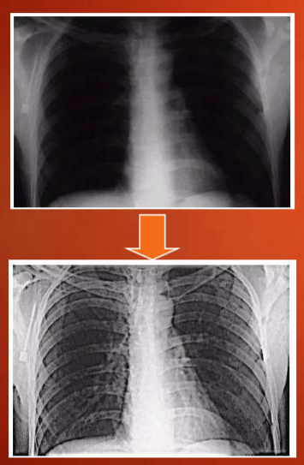
Image enhancement

Slide 22
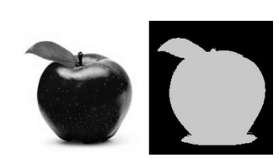
Thresholding

Slide 23
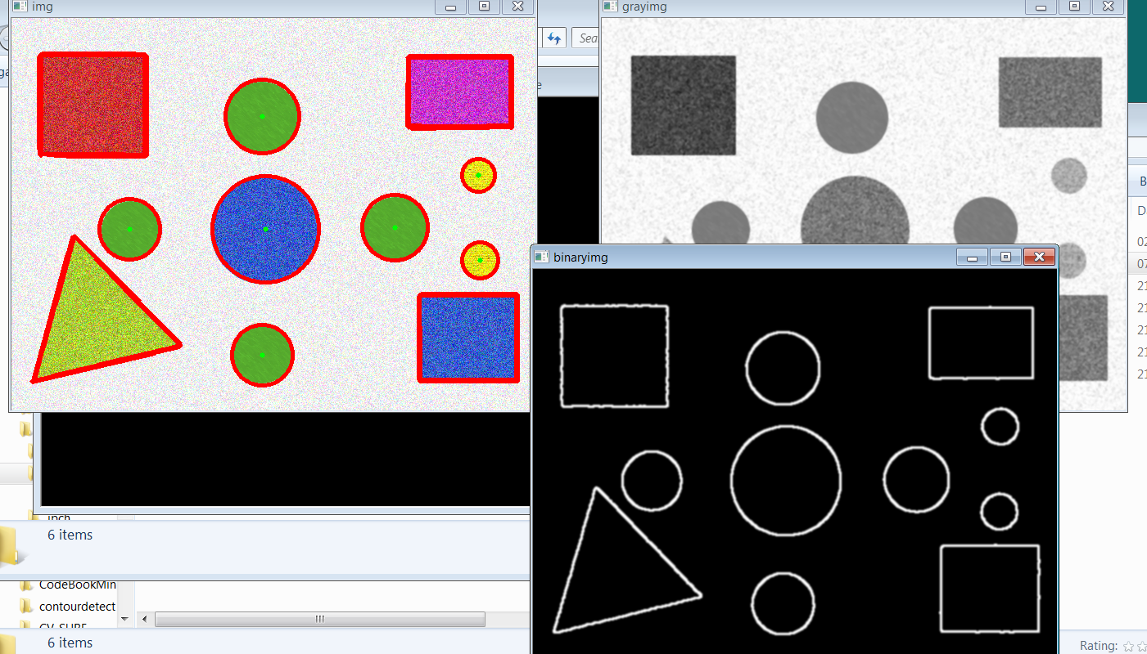
Edge detection

Slide 24
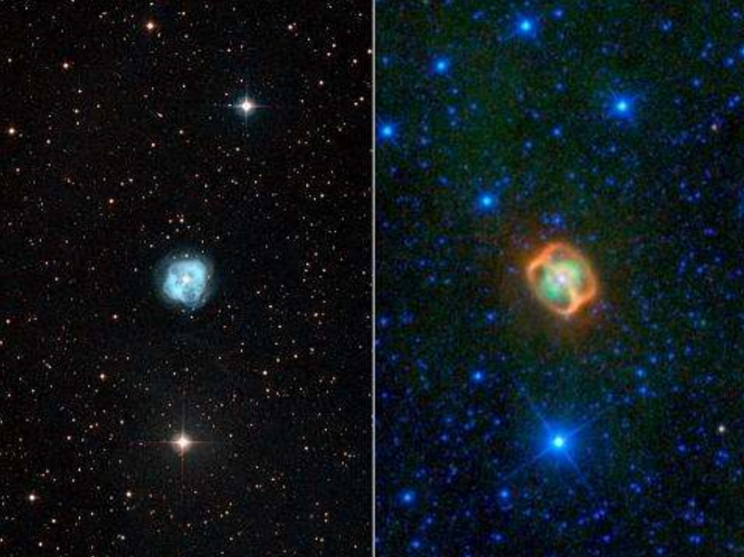
Imaging in astronomy
Fig. Nebula NGC 1514 01 in Visible (left) and Infrared (right)

Slide 25
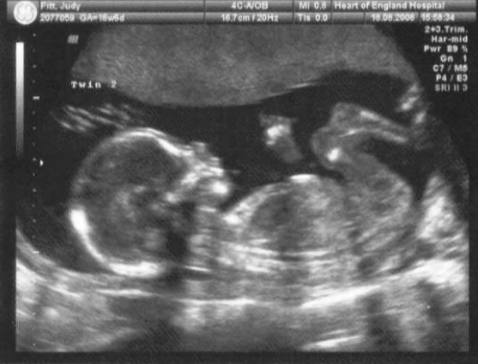
Ultrasound imaging
Ultrasound imaging (sonography) is a diagnostic medical procedure that uses high-frequency sound waves to produce dynamic visual images of organs, tissues or blood flow inside the body. Ultrasound is based on sonar, and uses a machine with a computer processor to create Ultrasound images.

Slide 26
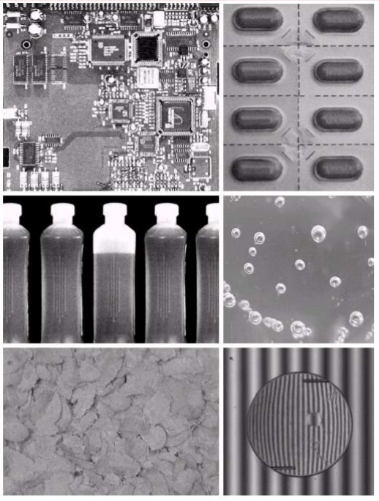
Industrial inspection
Human operators are expensive, slow and unreliable
Make machines do the job instead

Slide 27
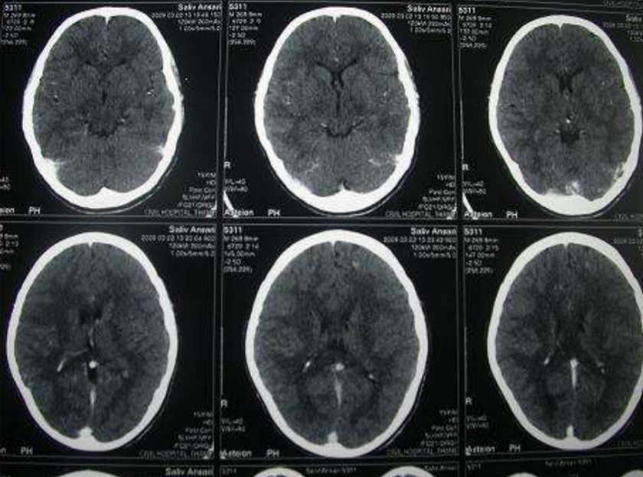
X-Ray imaging (Medical)

Slide 28
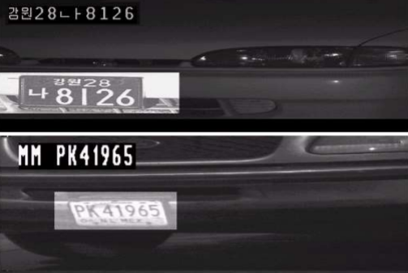
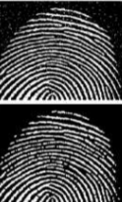
Image processing used by Law Enforcement
Car number plate
Finger print

Slide 29
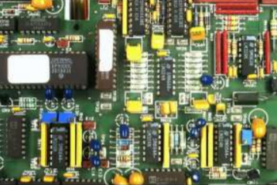
Printed Circuit Board (PCB) inspection
Machine inspection is used to determine that all components are present and that all solder joints are acceptable
Both conventional imaging and x-ray imaging are used

Slide 30
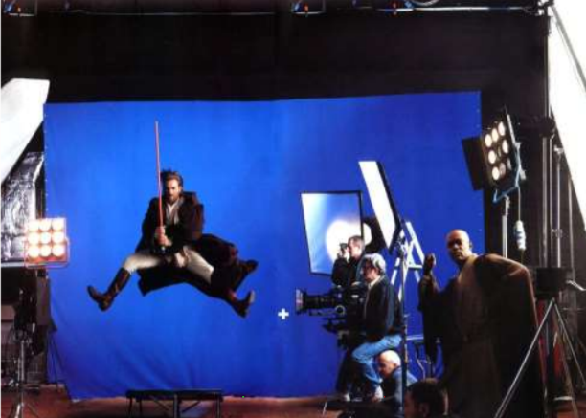
Special effects
Artistic effects are used to make images more visually appealing, to add special effects and to make composite images

Slide 31
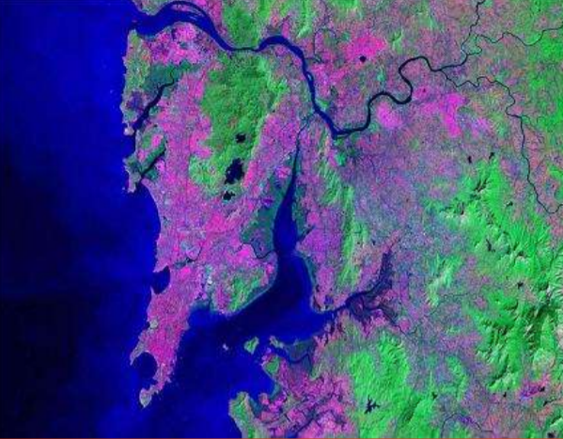
Remote Sensing
Satellite Image

Slide 32
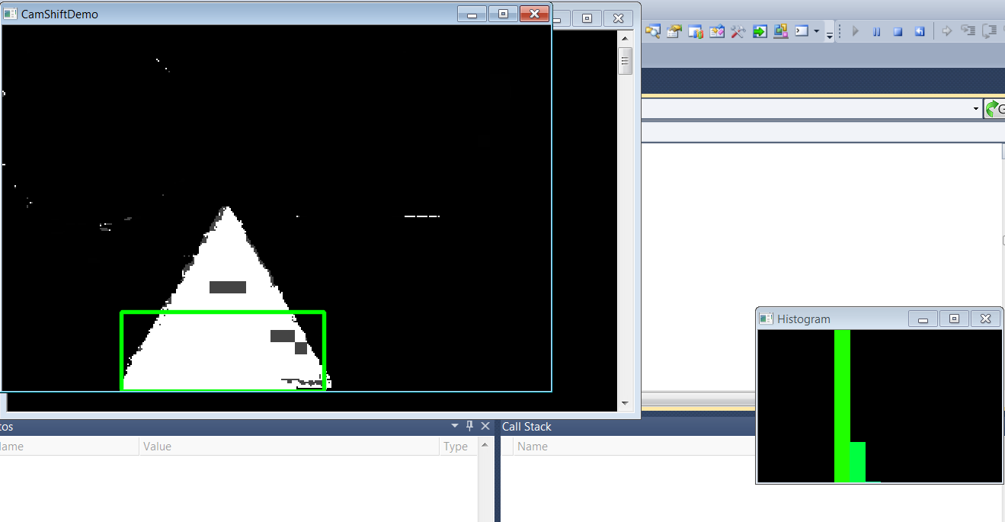
Use of Histogram
Histograms can be used to characterize the image's content and to detect specific objects or textures in an image..

Slide 33
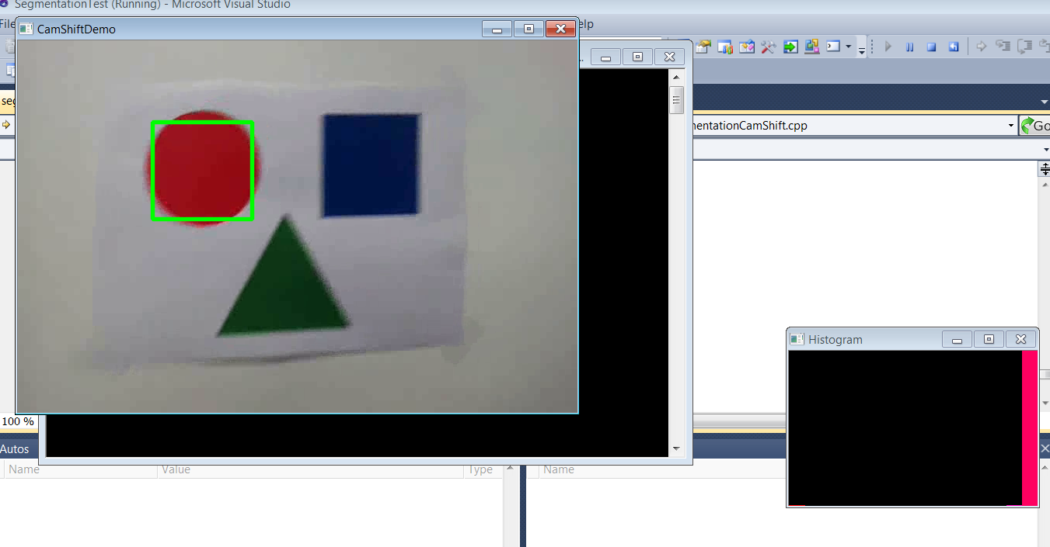
Track color object

Slide 34
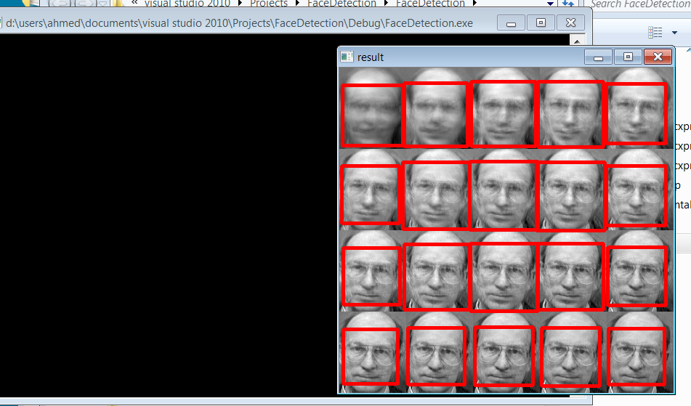
Detected face

Slide 35
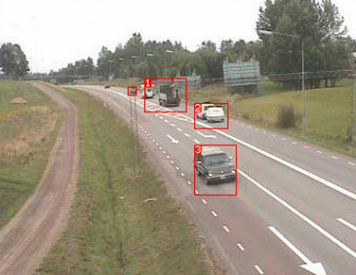
Motion Detection
Action of sensing physical movement in a given area
Motion can be detected by measuring change in speed or vector of an object

Slide 36
Goals of motion detection
  Identify moving objects
  Detection of unusual activity patterns
  Computing trajectories of moving objects
  Applications of motion detection
  Indoor/outdoor security
  Real time crime detection
  Traffic monitoring
  Many intelligent video analysis systems are based on motion detection.

Slide 37
Two popular approach for motion detection
A. Change detection
  Detect objects within a scene
  Track object across a number of frames
B. Optical Flow
  Compute motion within region or the frame as a whole

Slide 38
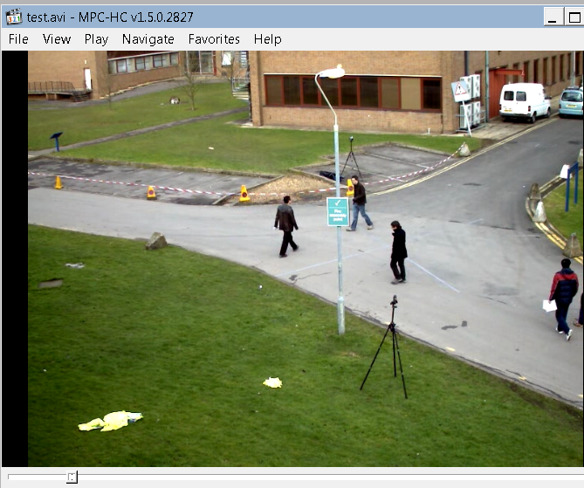
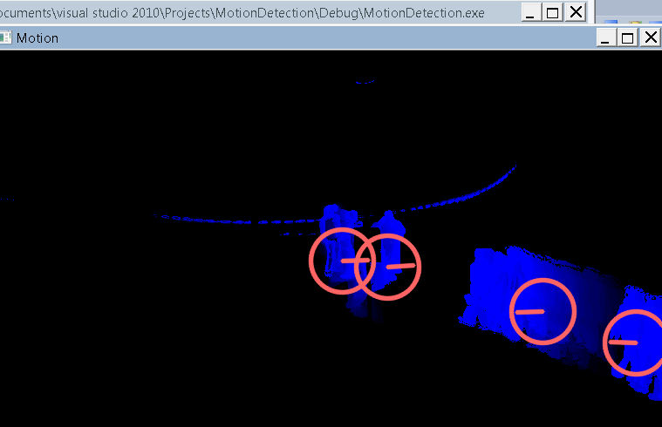
Motion detection
Input video
Detected motion

Slide 39
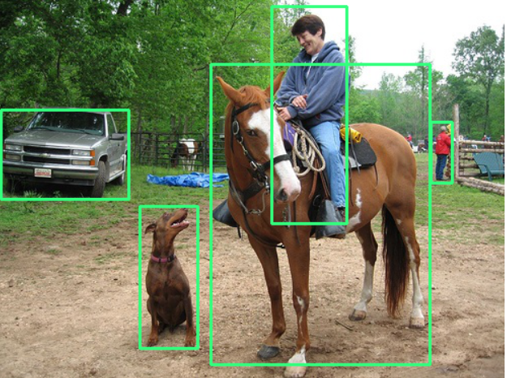
Object detection
Computer Vision is a field of computer science that works on enabling computers to see, identify and process images in the same way that human vision does and then provide appropriate output.

Slide 40
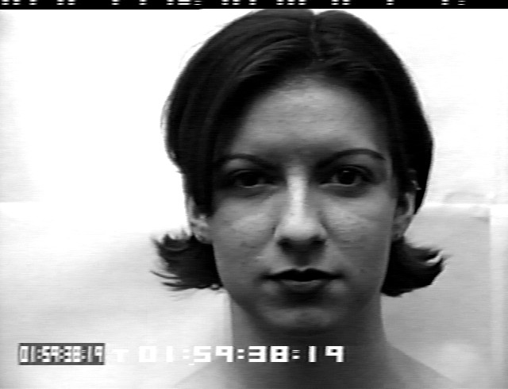
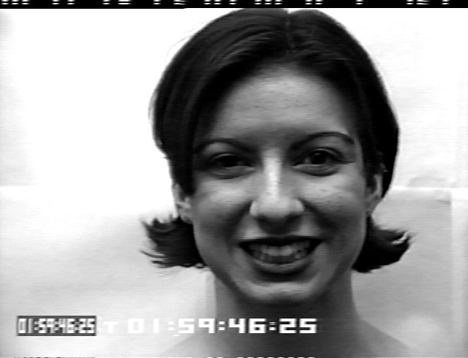
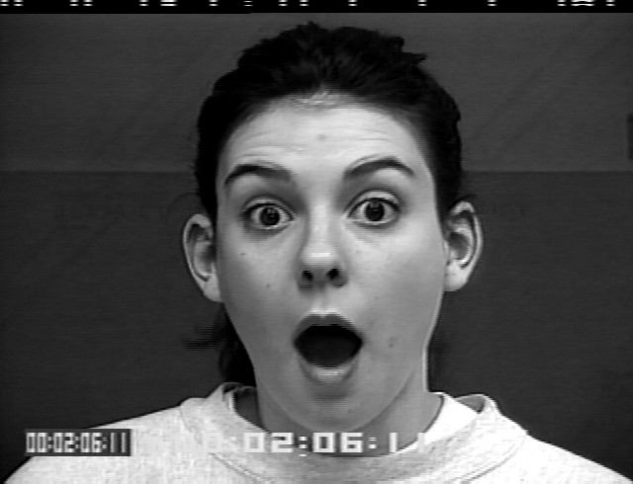
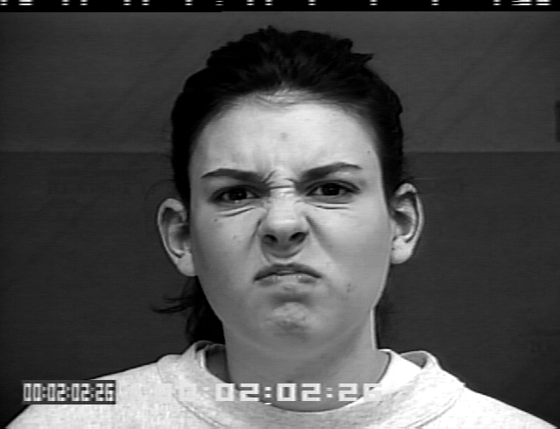
Facial expression recognition

Slide 41
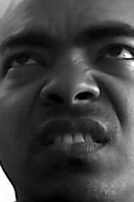
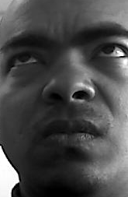
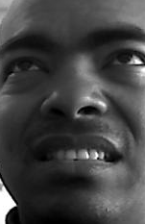
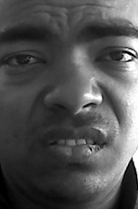
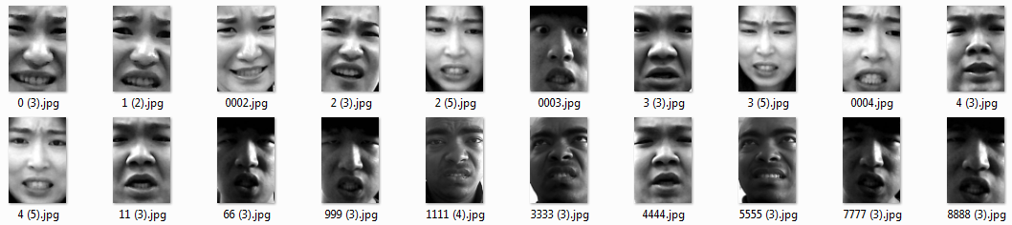
  Face expression Recognition in wild
Applications
HCI (human computer interaction)
Identity confirmation
Persons emotion recognition and
Different access control.
Challenges
face dissimilarity in pose,
ages,
lighting condition,
occlusion and face motion.
ITLab Face dataset

Slide 42
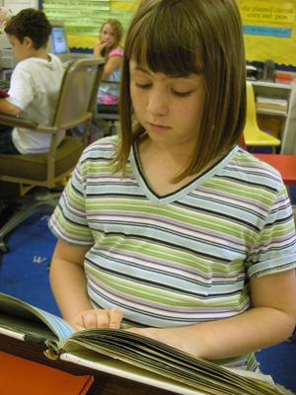

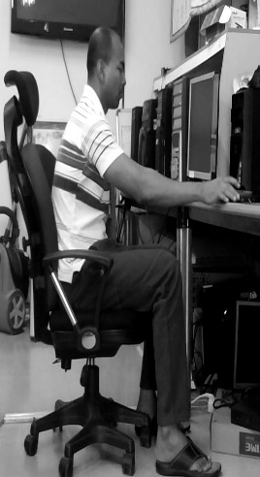

Human Action classification
Human physical body movement
  E.g. running, walking, reading.
Interaction with environment with object for specific
purpose.
  Using computer , taking photograph ..
Notes:
What are human actions

Slide 43

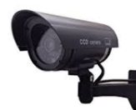
Applications of HAR
  Security surveillance
    E.g. airport, bus station
  Content-based browsing
  E.g. fast-forward to the next goal scoring scene
  Helping elderly people
    E.g. hospital elderly person, handicapped person
  Video recycling
  E.g. eliminating harmful video content from children

Slide 44

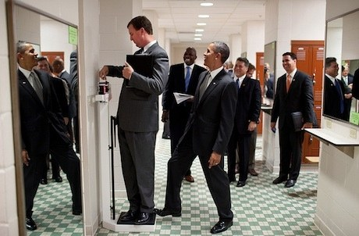


Challenges for Human Action Recognition
Variation in pose
Complex background
Object scale
Occlusion
Camera motion
Large Number of unlabeled data
Easy to miss interpretation of action
Image source : google &Stanford 40 action dataset

Slide 45

Traditional Human action recognition methods
Challenges for traditional method:
– Rely on human domain knowledge much more than data
– Feature design is separate from training the classifier
– If hand crafted features have multiple parameters, it is hard to manually tune them
– Developing effective features for new applications is slow
Notes:
Traditional Model
Learned
Hand designed, hard
Shallow or linear classifier is not enough (operation on raw pixels could not possibly distinguish)

Slide 46

Recent Deep learning based approach
transformations of the data that make it easier to extract useful information when building classifiers
– Jointly learning feature transformations and classifiers makes their integration optimal
– Learn the values of a huge number of parameters in feature representations
– Make better use of large data
– Faster to get feature representations for new applications
Image source : google
Notes:
Deep models
Learned jointly
Tied like biological system

Slide 47


Human action recognition

Slide 48


Other applications of computer vision
self-driving cars
Robotic surgery and medical diagnosis

Slide 49

Applications of computer vision
Robots that can navigate our clutter world — Robotic chefs, farmers, assistants

Slide 50


Applications of computer vision
Intelligent surveillance and drones
Indoor navigation
Drone

Slide 51


Applications of computer vision
Creation of Art
Social and Fun applications — like Instagram filters, etc

Slide 52

Applications of computer vision
3D reconstruction
Notes:
Real time indoor 3D scene reconstruction

Slide 53

Applications of computer vision
Augmented reality

Slide 54

Application of ML tasks
Figure : A model for how a viewer rates a movie

Slide 55

Basic setup of the learning problem
Figure: Basic setup of the learning problem

Slide 56

Different type of graph related Tasks

Slide 57

Applications of graph related ML task

Slide 58

Example protein folding
Examples of Node- level ML Tasks

Slide 59

Example of protein folding problem
Examples of Node- level ML Tasks

Slide 60

Application: Recommender system
Examples of Edge- level ML Tasks

Slide 61

Application: Drug side effect
Examples of Edge- level ML Tasks

Slide 62

Bio-medical graph link prediction
Examples of Edge- level ML Tasks

Slide 63

Example traffic prediction
Examples of sub graph level ML Tasks

Slide 64

Road network as a graph
Nodes: Road segments ○ Edges: Connectivity between road segments ○ Prediction: Time of Arrival (ETA)
Examples of sub graph level ML Tasks

Slide 65

Traffic prediction via GNN
Examples of sub graph level ML Tasks

Slide 66

Applications: Drug discovery
○ Antibiotics are small molecular graphs
▪ Nodes: Atoms
▪ Edges: Chemical bonds
Examples of graph level ML Tasks

Slide 67

Reference

Slide 68

Question

Slide 69

Thank you

